Slide 1


Porter Stemmer: Design, Working Mechanism, and Applications
COURSE CODE :DSA0304
Natural Language Processing
presented by
C .Tharun (192472309)
supervised by
Dr. T.DEVI
L

Slide 2
INTRODUCTION
Porter Stemmer is a rule-based stemming algorithm developed by Martin Porter in 1980.
It reduces different forms of a word to a common root word (stem) by removing prefixes and suffixes.
Stemming is an important text preprocessing technique in Natural Language Processing (NLP).
It helps computers process text efficiently by reducing vocabulary size. Porter Stemmer is widely used in search engines, information retrieval systems, and text mining applications.

Slide 3
SYSTEM ALGORITHM
Working Algorithm of Porter Stemmer
The Porter Stemmer processes words through a sequence of rule-based steps.
Algorithm Steps:
Input the word.
Identify the suffix (e.g., -ing , -ed , -ly , -tion ).
Apply predefined stemming rules.
Remove or replace the suffix.
Generate the stem (root word).

Slide 4
WORKFLOW
Input Word
Identify Suffix
Apply Stemming Rules
Remove/Replace Suffix
Generate Stem Word

Slide 5
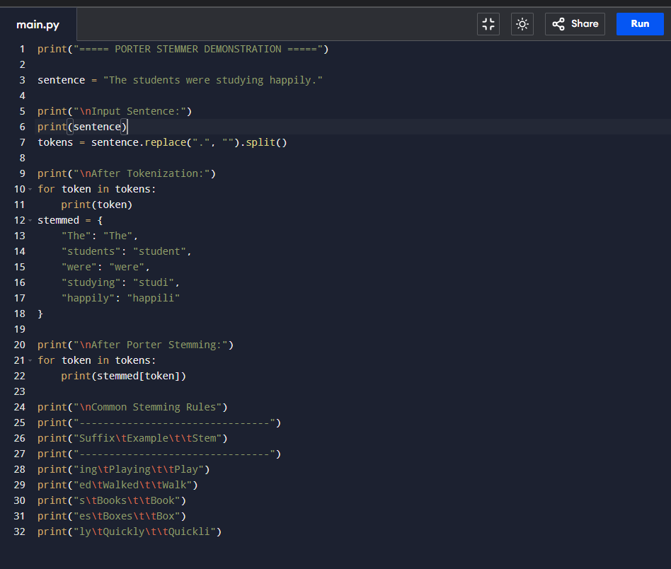
Working Example

Slide 6
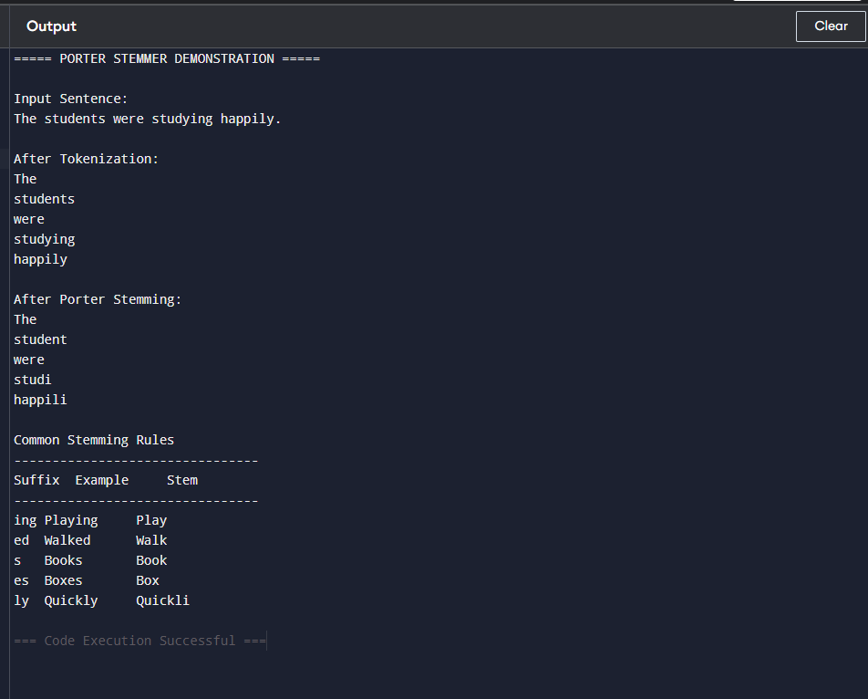
OUTPUT

Slide 7
Conclusion
Porter Stemmer is one of the most widely used stemming algorithms in NLP.
It converts different word forms into a common root by applying rule-based suffix removal.
The algorithm improves the efficiency of text processing, search, and information retrieval.
Despite limitations such as over-stemming, it remains a simple, fast, and effective preprocessing technique.
Porter Stemmer continues to play an important role in modern NLP applications.

Slide 8
THANK YOU

